Slide 1
Augmenting The Readability and Traceability of Software Documentation – From Investment Banking to SE Research
Aidan Yang

Slide 2


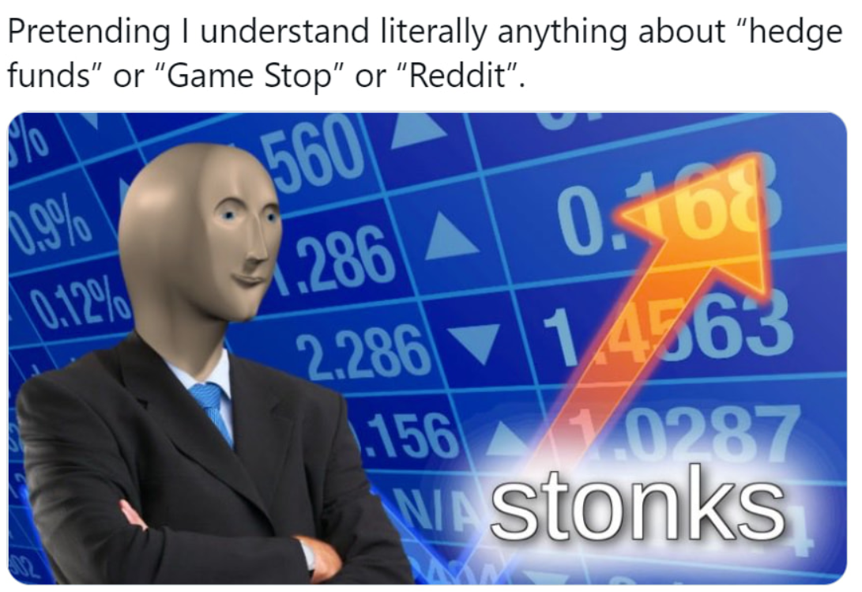

IPO: Initial Public Offering
Offering shares of a private corporation to the public
Why?
Raise capital
Increase exposure
Prestige
Memes

Slide 3



My Role
Tracing SEC requirements with client financial statements within last 5 years

Slide 4
Questions in Financial Documents
Corporations strategize around quarterly earning reports.
Investors use earning reports for investment decisions.
Bankers/lawyers trace financial documents with SEC regulations.

Slide 5
Questions in Financial Documents
Questions in Software Documents
Corporations strategize around quarterly earning reports.
Do software teams care about release documentation?
How do software developers write release documentation?
Investors use earning reports for investment decisions.
Does release documentation affect user decisions?
Can software documentation and source code be traced automatically?
Bankers/lawyers trace financial documents with SEC regulations.

Slide 6

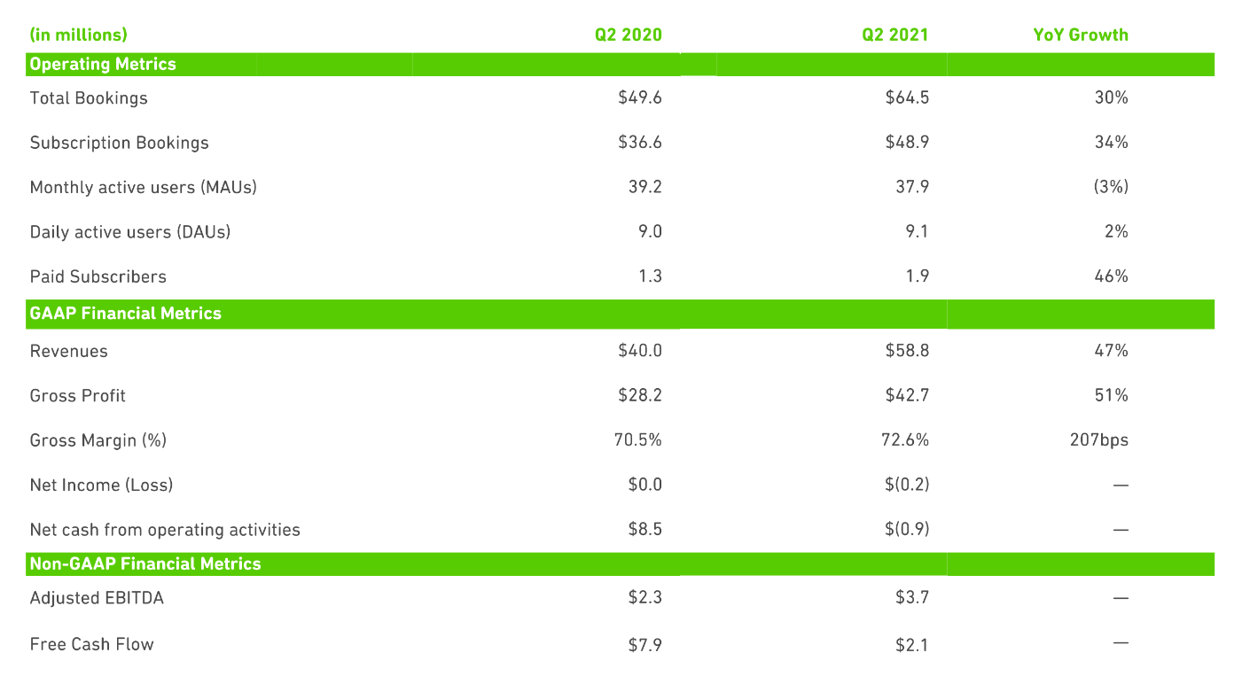
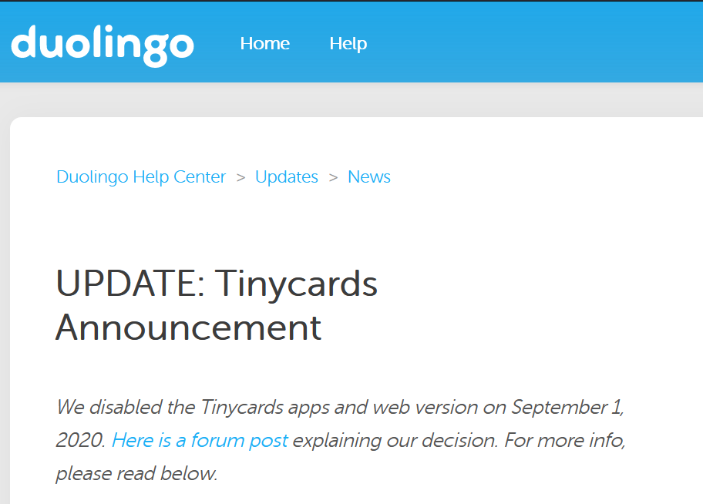

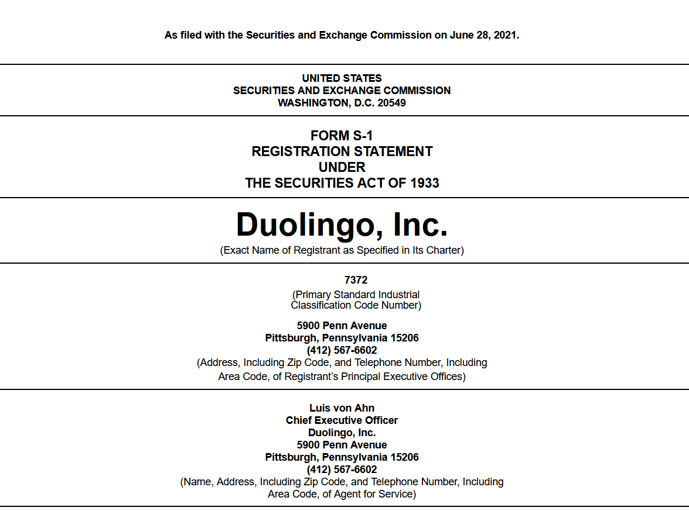

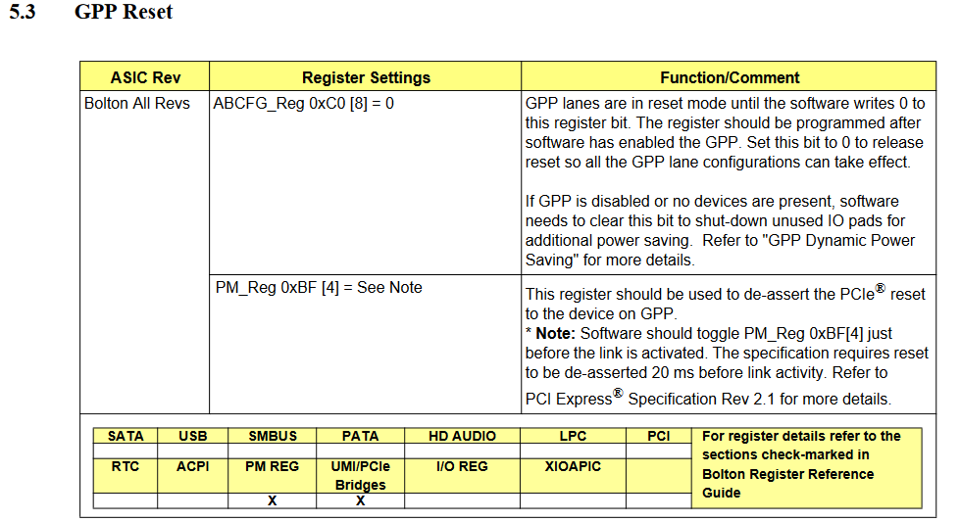


Financial Documents
Software Documents
Earnings report
Accountants
??
IBanks
IPO
forms

Slide 7
Questions in Financial Documents
Questions in Software Documents
Corporations strategize around quarterly earning reports.
Do software teams care about release documentation?
How do software developers write release documentation?
Investors use earning reports for investment decisions.
Does release documentation affect user decisions?
Can software documentation and source code be traced automatically?
Bankers/lawyers trace financial documents with SEC regulations.

Slide 8
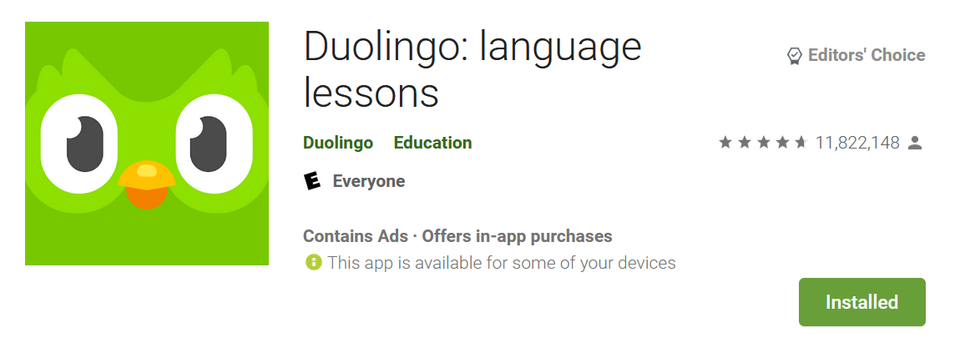
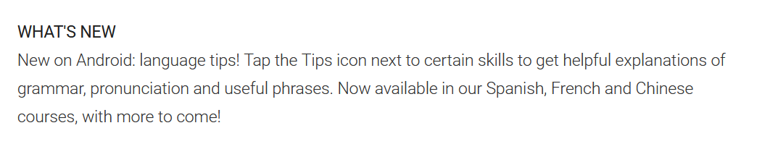
Project 1: Empirical Study of Release Notes
When you publish release notes instead of saying the blanket bug fixes, maybe you should try to make a useful statement instead.
Setting up fingerprint login should have been announced in the release
notes not hidden in the options!"
User Reviews

Slide 9
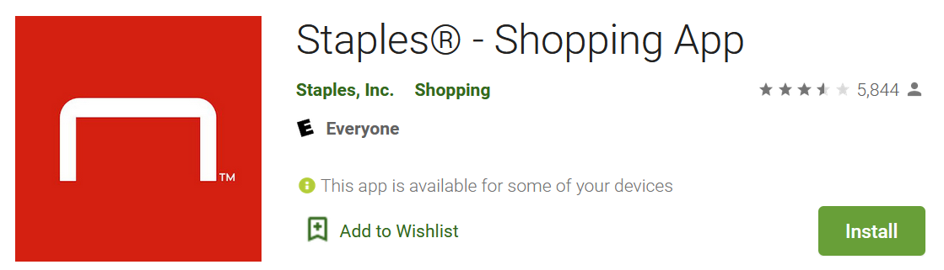
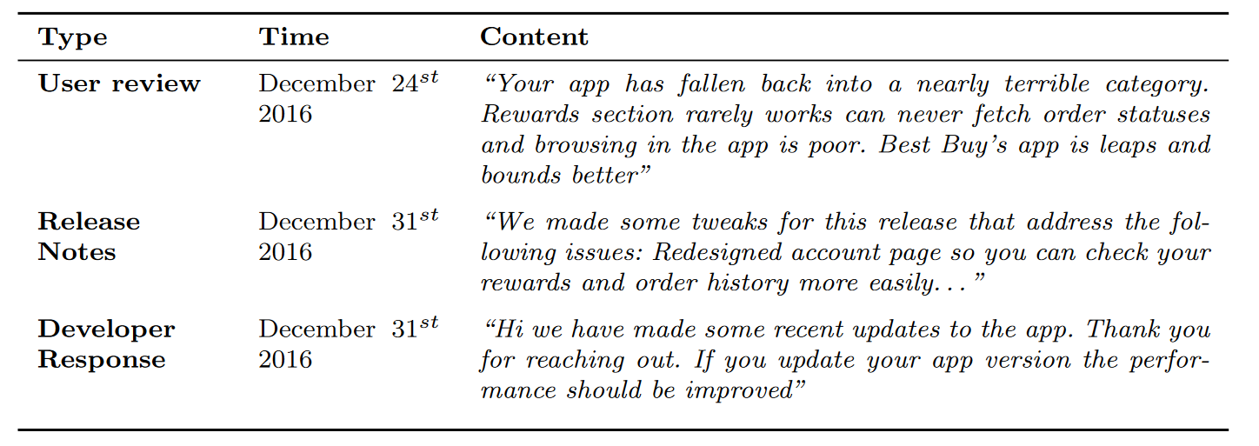
User – Developer Dialogue

Slide 10
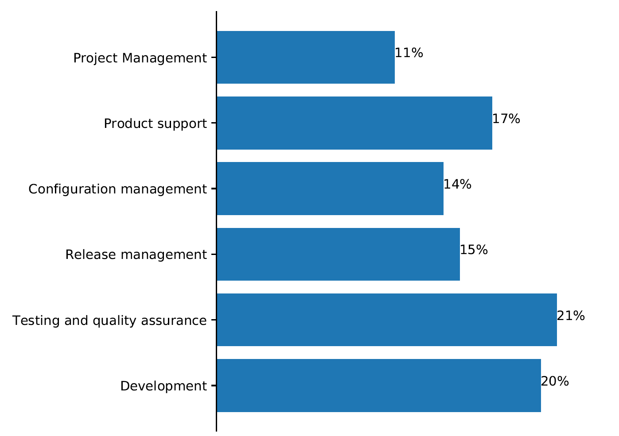
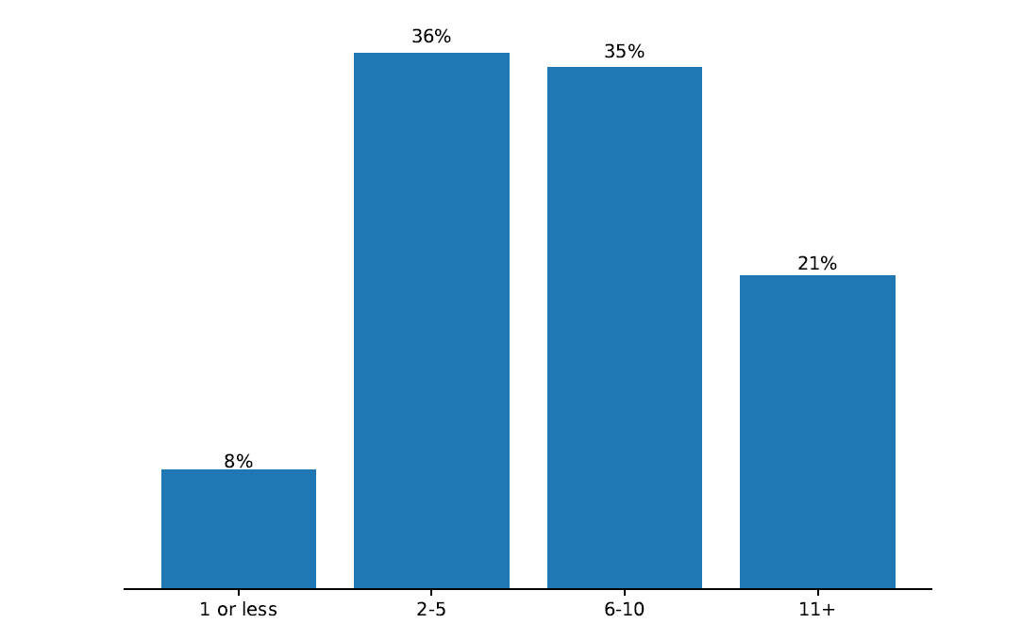
We Surveyed 102 Developers
The distribution of the years of experience of the surveyed developers
The distribution of the job roles of the surveyed developers.

Slide 11
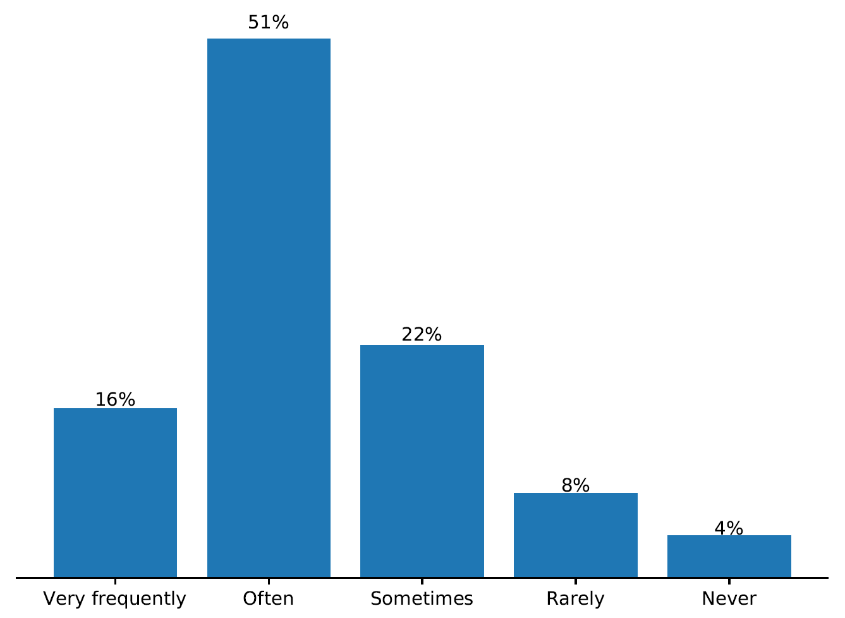
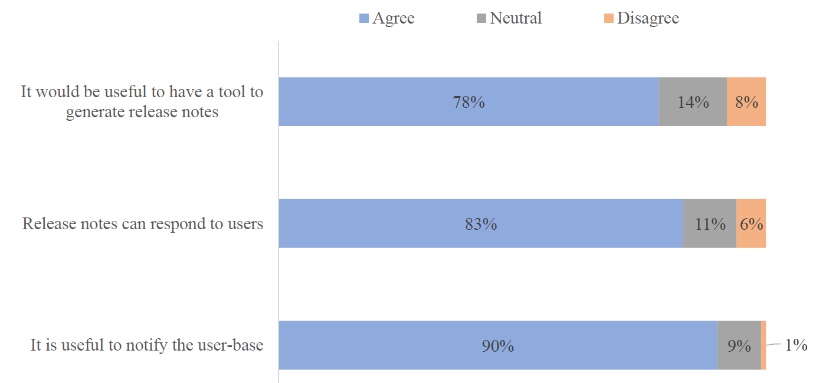
We Surveyed 102 Developers
Developers' answers for frequency of release note update.
Developers' answers for release note uses.

Slide 12
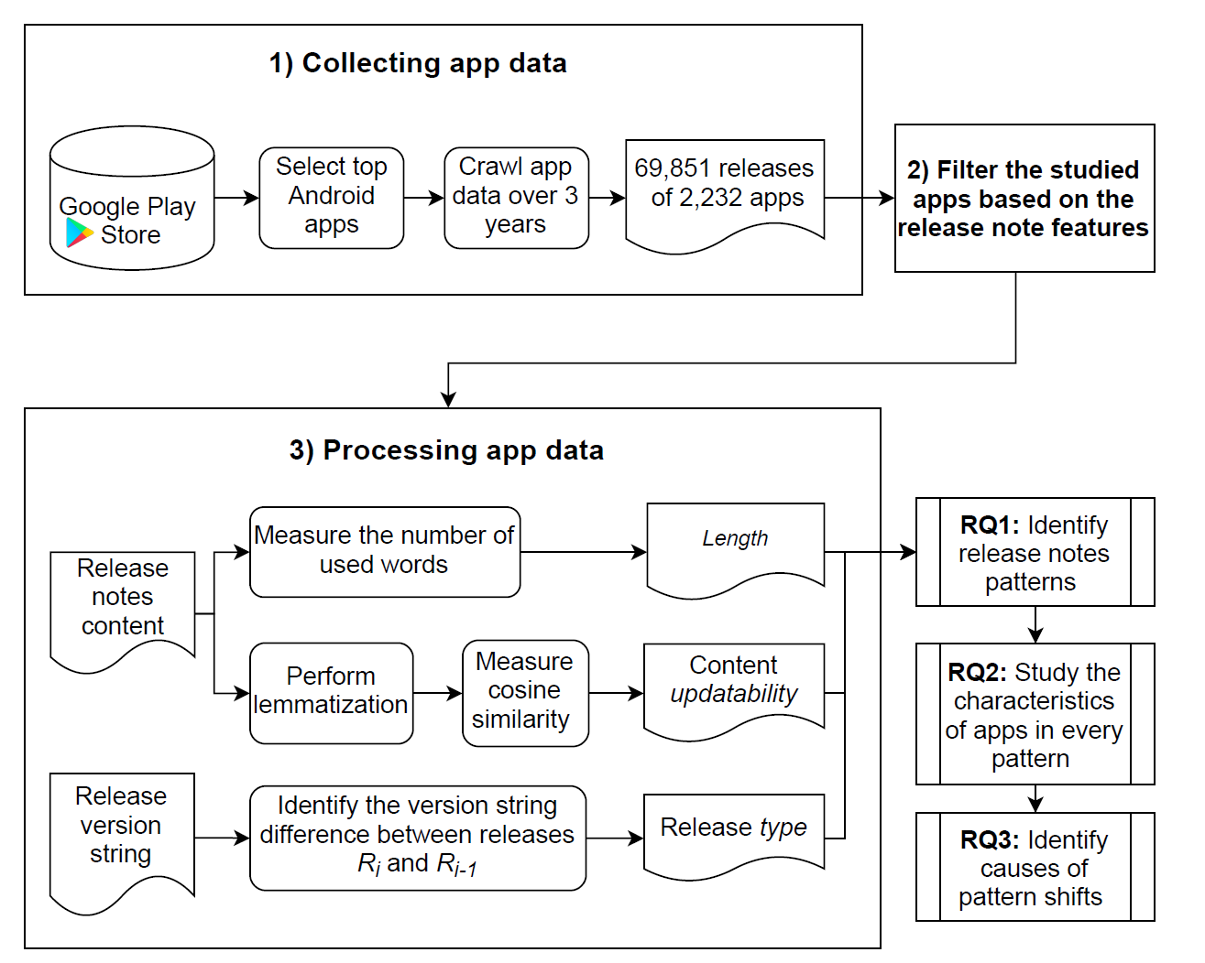
We collected data of the studied 2,232 apps over the period of three years. We collect 70 thousand releases, 67 million user reviews and 2.9 million developer responses.
Data Collection

Slide 13
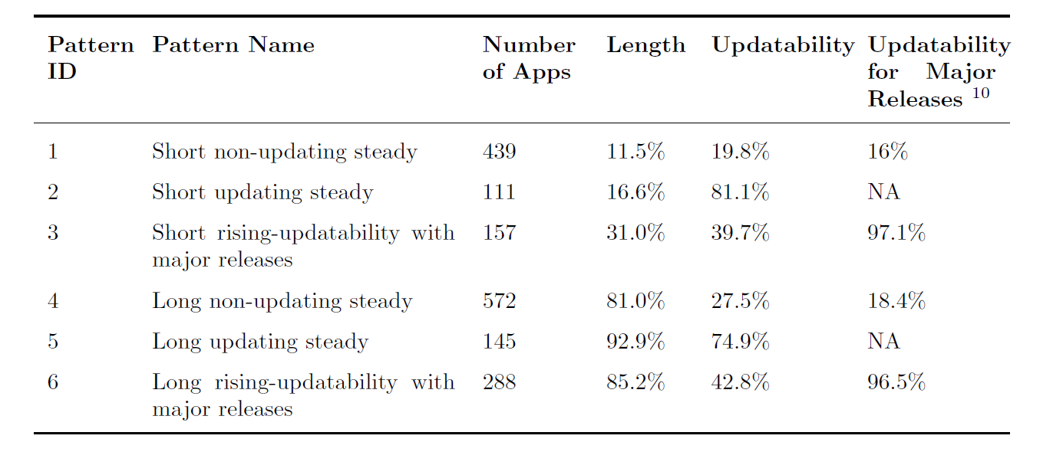
We Observe 6 Release Note Patterns
Example release notes:
GUI enhancements and minor fixes
Fix a bug of the grouping separator. Improved calculation precision

Slide 14
Questions in Financial Documents
Questions in Software Documents
Corporations strategize around quarterly earning reports.
Do software teams care about release documentation?
Yes! [EMSE’21]
Investors use earning reports for investment decisions.
Do release notes affect user decisions?
Can software documentation and source code be traced automatically?
Bankers/lawyers trace financial documents with SEC regulations.

Slide 15
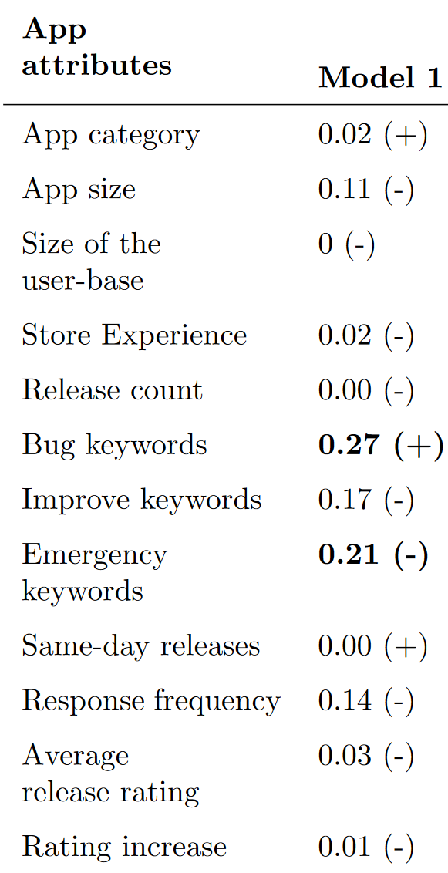
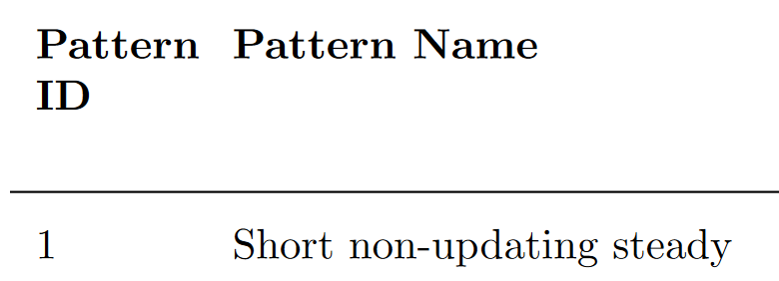
Regression Models
We build 6 logistic regression models on each of the 6 patterns to observe if certain app attributes are correlated with release note patterns.
Significant

Slide 16
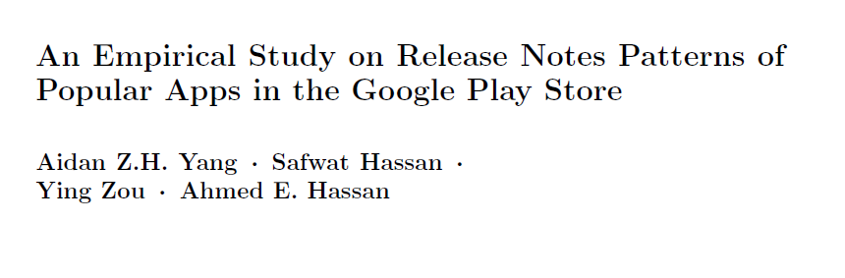
Contributions
We identify six patterns of release notes.
Apps with long and updating release notes have high perceived quality releases, an increase in user ratings, and informative release notes.
Our work shows potential directions for developers to improve the release notes mechanisms in app stores.
Published at EMSE as :

Slide 17
Questions in Financial Documents
Questions in Software Documents
Corporations strategize around quarterly earning reports.
Do software teams care about release documentation?
Yes! [EMSE’21]
Investors use earning reports for investment decisions.
Do release notes affect user decisions?
Yes, release notes affect how users perceive apps [EMSE’21]
Can software documentation and source code be traced automatically?
Bankers/lawyers trace financial documents with SEC regulations.

Slide 18
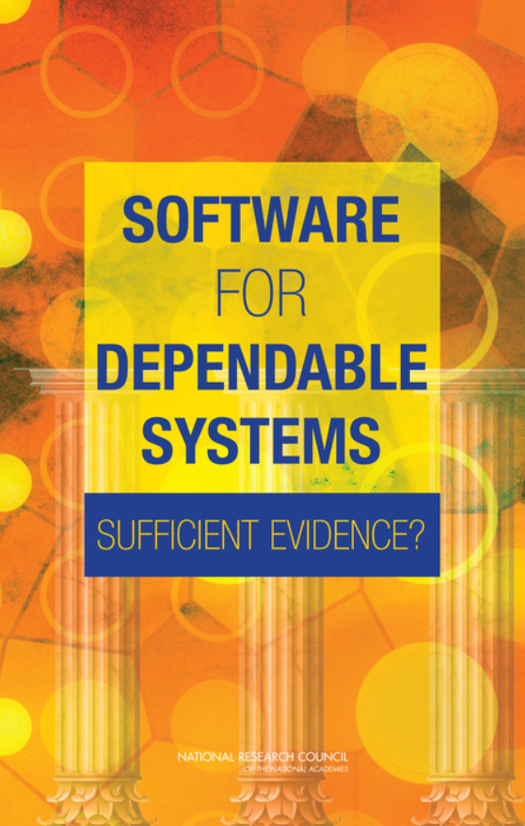
It’s Not Just About the Bugs
Study by the National Academy of Sciences
Failures due to software in:
Aviation, medical devices, energy grids, defense, electronic voting …
Bugs in code only account for 3% of failures
Most failures caused by a poor understanding of system requirements and specification

Slide 19
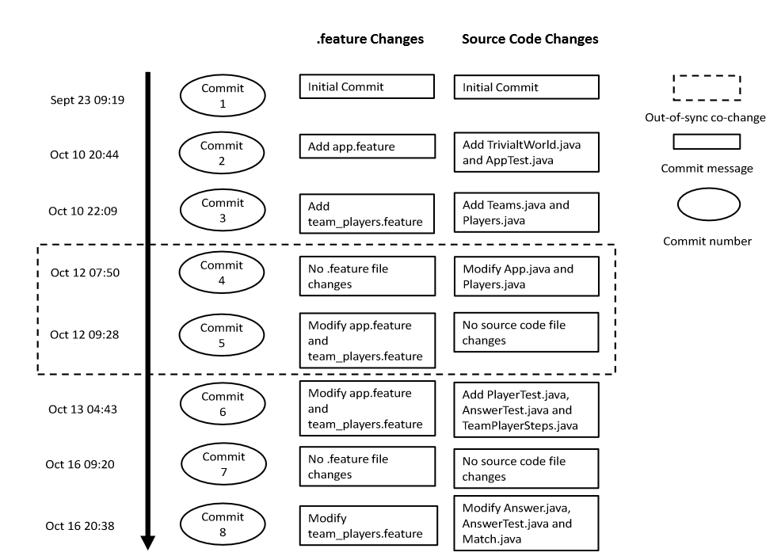
Project 2: Out-of-Sync Co-Changes of Requirements and Source Code in the Cucumber Framework

Slide 20






Motivation
Out-of-synch co-change reduces benefits of Behavior Driven Development
New developers entering a project struggle to understand requirements in Cucumber
BDD

Slide 21
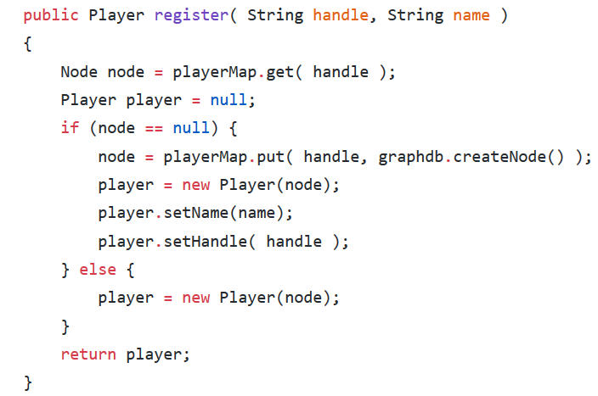
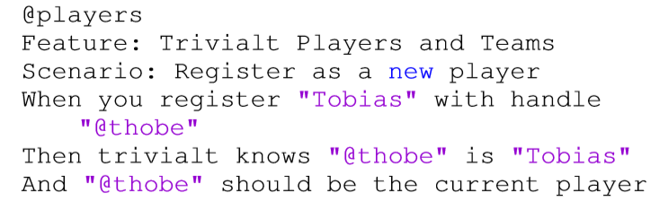
Link .Feature Files and Source Code Using Semantic Similarity
Characteristics of .Feature Files
Characteristics of Source Code Files
Method Name
Key
Variable Name
Noun
Verb
Proposition
Java Terms

Slide 22
Analysis of Links in the Sample
Manual Analysis Sample size of 451.
Our Approach Yields
79% Accuracy
360 co-changing work items actually linked together.
80% agreement rate after inspection by another author.

Slide 23





Modify .Feature Files to Maximize BDD Advantages When…
Adding and renaming test files
Modifying all other files
Modify .feature files!
Deleting source code
Published at MSR 2019 as:

Slide 24
Questions in Software Documents
Questions in Financial Documents
Corporations strategize around quarterly earning reports.
Do software teams care about release documentation?
Yes! [EMSE’21]
Investors use earning reports for investment decisions.
Do release notes affect user decisions?
Yes, release notes affect how users perceive apps [EMSE’21]
Can software documentation and source code be traced automatically?
Bankers/lawyers trace financial documents with SEC regulations.
In certain testing strategies using constrained grammar [MSR’19]

Slide 25

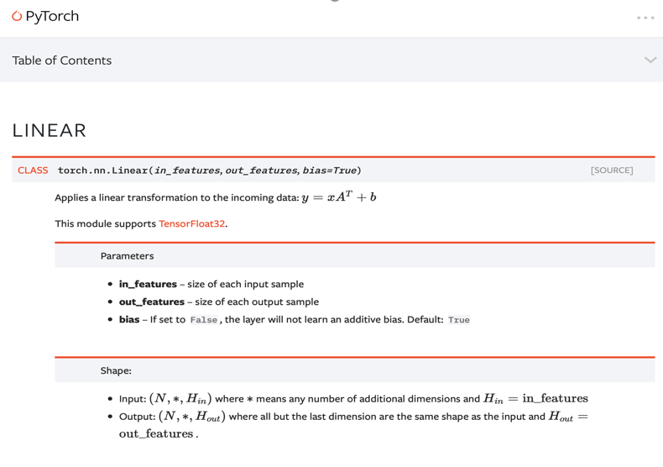
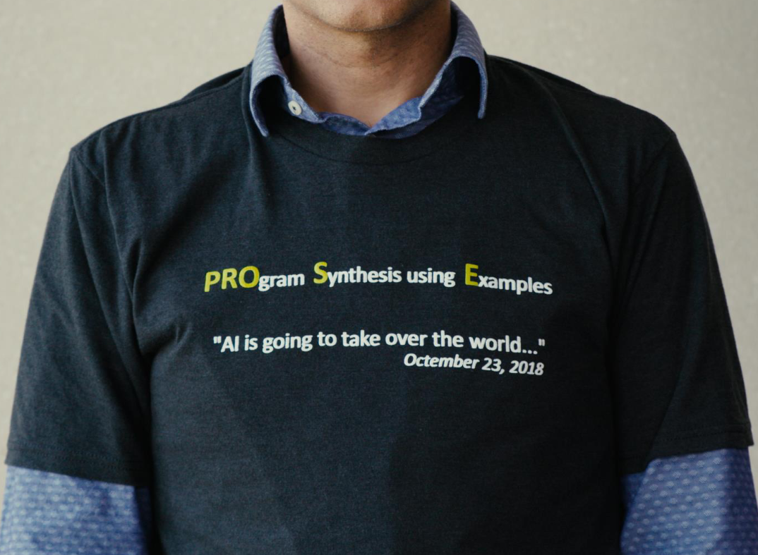

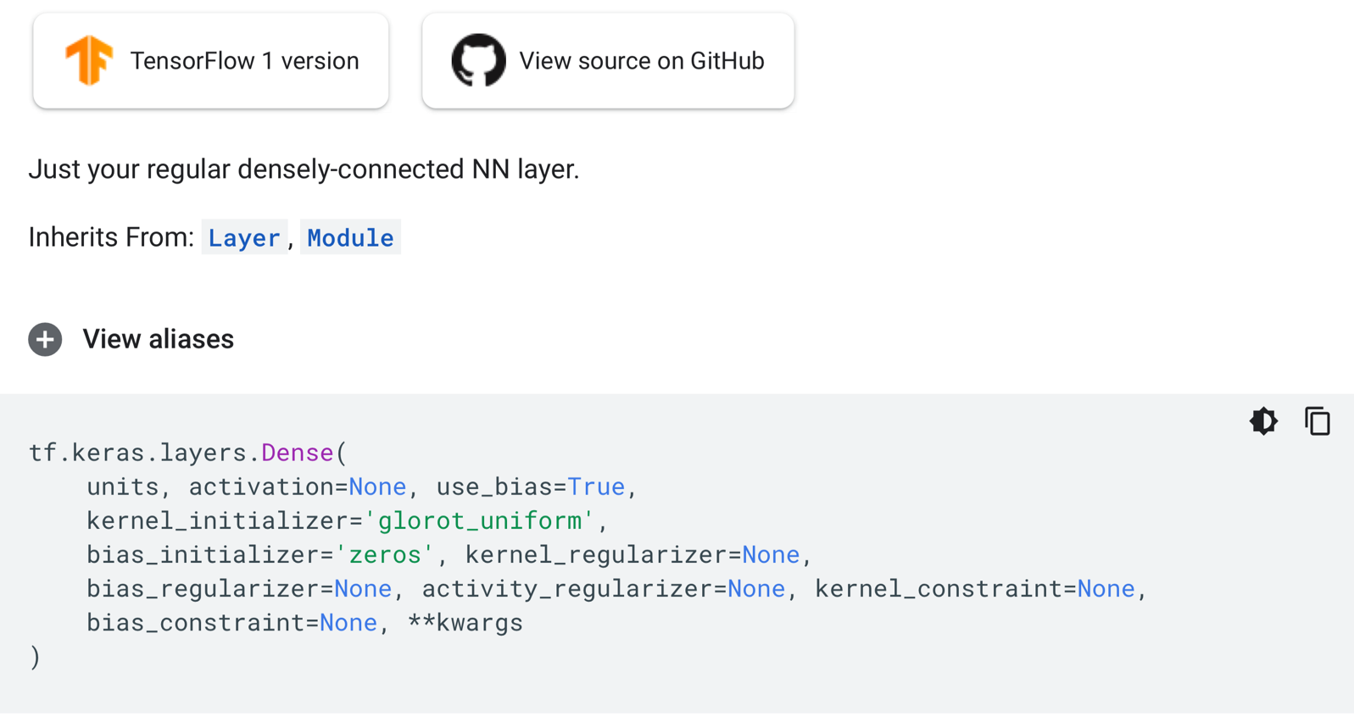
Done?

Slide 26

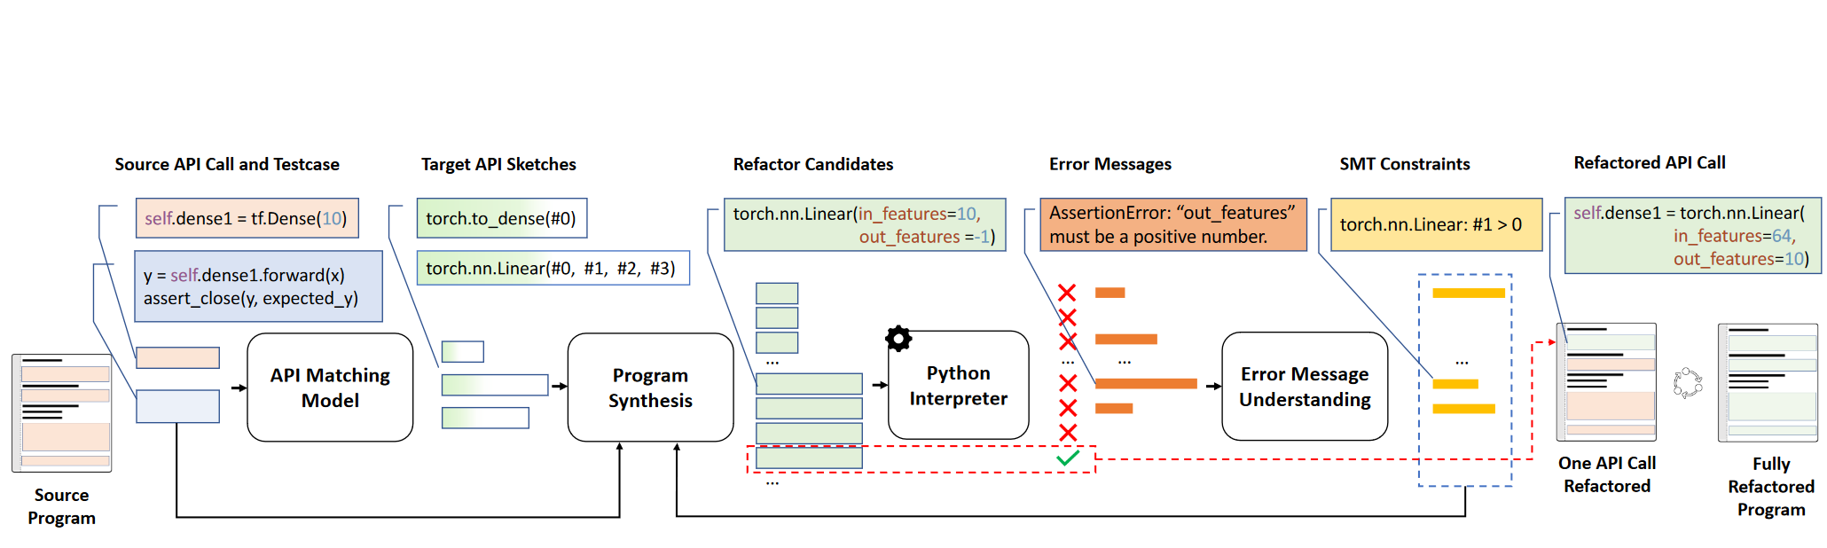
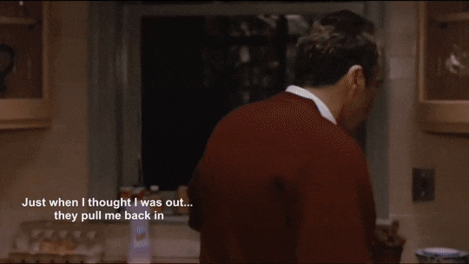
Claire Le : Try SE Research at CMU!
Just when I thought I was out…
They pull me back in [Pacino90]

Slide 27
